Slide 1

Chapter 2
Cyberoffenses: How Criminals
Plan Them

Slide 2
Introduction
In today’s world of Internet and computer networks, a criminal activity can be carried out across national borders with “false sense of anonymity”.
An attacker would look to exploit the vulnerabilities in the networks such as:
1. Inadequate border protection (border as in the sense of network periphery);
2. remote access servers (RASs) with weak access controls;
3. application servers with well-known exploits;
4. misconfigured systems and systems with default configurations.
Categories of Cybercrime
Cybercrime can be categorized based on the following:
1. The target of the crime and
2. whether the crime occurs as a single event or as a series of events.
The target of the crime
Crimes targeted at individuals
Crimes targeted at property
Crimes targeted at organizations
Single event of cybercrime
Series of events

Slide 3
How Criminals Plan the Attacks
1. Reconnaissance (information gathering) is the first phase and is treated as passive attacks.
2. Scanning and scrutinizing the gathered information for the validity of the information as well as to identify the existing vulnerabilities.
3. Launching an attack (gaining and maintaining the system access).
Reconnaissance
“Reconnaissance” is an act of reconnoitering – explore, often with the goal of finding something or somebody (especially to gain information about an enemy or potential enemy).
Reconnaissance begins with “Footprinting” – this is the preparation toward pre-attack phase
involves accumulating data about the target’s environment and computer architecture to find ways to intrude into that environment.
Passive Attacks
A passive attack involves gathering information about a target without his/her (individual’s or company’s) knowledge.
It is usually done using Internet searches or by Googling an individual or company to gain information.

Slide 4
Active Attacks
An active attack involves probing the network to discover individual hosts to confirm the information gathered in the passive attack phase.
It involves the risk of detection and is also called “Rattling the doorknobs”or “Active reconnaissance.”
Active reconnaissance can provide confirmation to an attacker about security measures in place.
Scanning and Scrutinizing Gathered Information
The objectives of scanning are:
1. Port scanning: Identify open/close ports and services.
2. Network scanning: Understand IP Addresses and related information about the computer network systems.
3. Vulnerability scanning: Understand the existing weaknesses in the system.
Attack (Gaining and Maintaining the System Access)
After the scanning and enumeration, the attack is launched using the following steps:
1. Crack the password;
2. exploit the privileges;
3. execute the malicious commands/applications;
4. hide the files (if required);
5. cover the tracks – delete the access logs, so that there is no trail illicit activity.

Slide 5
Social Engineering
It is the “technique to influence” and “persuasion to deceive” people to obtain the information or perform some action.
Social engineers exploit the natural tendency of a person to trust social engineers’ word, rather than exploiting computer security holes.
Social engineering involves gaining sensitive information or unauthorized access privileges by building inappropriate trust relationships with insiders.
The sign of truly successful social engineers is that they receive information without any suspicion.
Classification of Social Engineering
1. Human-Based Social Engineering
Human-based social engineering refers to person-to-person interaction to get the required/desired information.
2. Computer-Based Social Engineering
Computer-based social engineering refers to an attempt made to get the required/desired information by using computer software/Internet.

Slide 6
Cyberstalking
It is defined as the use of information and communications technology, particularly the Internet, by an individual or group of individuals to harass another individual, group of individuals, or organization.
Cyberstalking refers to the use of Internet and/or other electronic communications devices to stalk another person.
It involves harassing or threatening behavior that an individual will conduct repeatedly.
As the Internet has become an integral part of our personal and professional lives, cyberstalkers take advantage of ease of communication and an increased access to personal information available with a few mouse clicks or keystrokes.
Types of Stalkers
There are primarily two types of stalkers as listed below:
Online stalkers: They aim to start the interaction with the victim directly with the help of the Internet.
Offline stalkers: The stalker may begin the attack using traditional methods such as following the victim, watching the daily routine of the victim, etc.

Slide 7
How Stalking Works?
Personal information gathering about the victim
Establish a contact with victim through telephone/cell phone. Once the contact is established, the stalker may make calls to the victim to threaten/harass.
Stalkers will almost always establish a contact with the victims through E-Mail. The stalker may use multiple names while contacting the victim.
Some stalkers keep on sending repeated E-Mails asking for various kinds of favors or threaten the victim.
The stalker may post the victim’s personal information on any website related to illicit services such as sex-workers’ services or dating services, posing as if the victim has posted the information and invite the people to call the victim on the given contact details The stalker will use bad and/or offensive/attractive language to invite the interested persons.
Whosoever comes across the information, start calling the victim on the given contact details asking for sexual services or relationships.
Some stalkers subscribe/register the E-Mail account of the victim to innumerable pornographic and sex sites, because of which victim will start receiving such kind of unsolicited E-Mails.
Cybercafe and Cybercrimes
Cybercrimes such as stealing of bank passwords and subsequent fraudulent withdrawal of money have also happened through cybercafes.
Cybercafes have also been used regularly for sending obscene mails to harass people.
Indian Information Technology Act (ITA) 2000 interprets cybercafes as “network service providers” referred to under the erstwhile Section 79, which imposed on them a responsibility for “due diligence” failing which they would be liable for the offenses committed in their network.

Slide 8
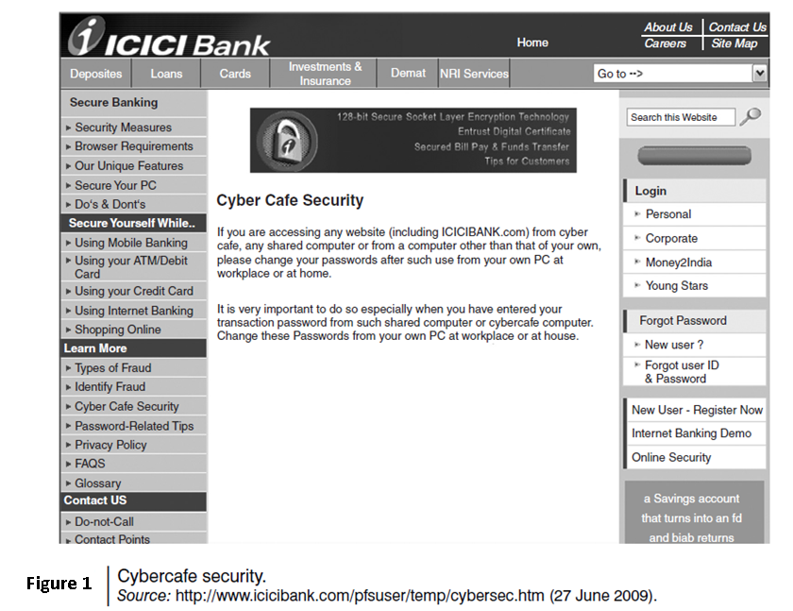

Slide 9
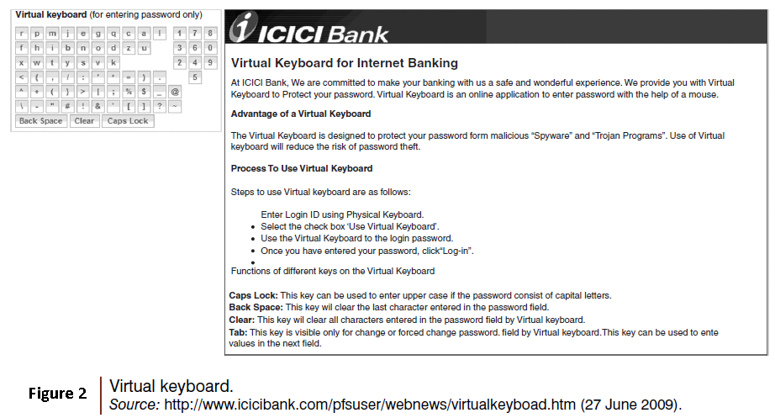

Slide 10
Cybercriminals can either install malicious programs such as keyloggers and/or Spyware or launch an attack on the target.
Here are a few tips for safety and security while using the computer in a cybercafe:
Always logout
Stay with the computer
Clear history and temporary files
Be alert
Avoid online financial transactions
Change passwords
Virtual keyboard
Security warnings
Botnets: The Fuel for Cybercrime
A Botnet (also called as zombie network) is a network of computers infected with a malicious program that allows cybercriminals to control the infected machines remotely without the users’ knowledge.
Your computer system maybe a part of a Botnet even though it appears to be operating normally.
Botnets are often used to conduct a range of activities, from distributing Spam and viruses to conducting denial-of-service (DoS) attacks.

Slide 11
One can ensure following to secure the system:
Use antivirus and anti-Spyware software and keep it up-to-date.
Set the OS to download and install security patches automatically.
Use a firewall to protect the system from hacking attacks while it is connected on the Internet.
Disconnect from the Internet when you are away from your computer.
Downloading the freeware only from websites that are known and trustworthy
Check regularly the folders in the mail box – “sent items” or “outgoing” – for those messages you did not send.
Take an immediate action if your system is infected.
Attack Vector
An “attack vector” is a path or means by which an attacker can gain access to a computer or to a network server to deliver a payload or malicious outcome.
Attack vectors include viruses, E-Mail attachments, webpages, pop-up windows, instant messages, chat rooms, and deception.
The most common malicious payloads are viruses, Trojan Horses, worms, and Spyware.
If an attack vector is thought of as a guided missile, its payload can be compared to the warhead in the tip of the missile.
Payload means the malicious activity that the attack performs.
It is the bits that get delivered to the end-user at the destination.

Slide 12
The attack vectors described here are how most of them are launched:
Attack by E-Mail
Attachments (and other files)
Attack by deception
Hackers
Heedless guests (attack by webpage)
Attack of the worms
Malicious macros
Foistware (sneakware)
Viruses
Cloud Computing Cloud computing services, while offering considerable benefits and cost savings makes it easier for cybercriminals to attack these systems.
Cloud computing is Internet (“cloud”)-based development and use of computer technology (“ computing”).
A cloud service has three distinct characteristics which differentiate it from traditional
hosting:
It is sold on demand
it is elastic in terms of usage
the service is fully managed by the provider.

Slide 13
Advantages of Cloud Computing
Cloud computing has following advantages:
1. Applications and data can be accessed from anywhere at any time.
2. It could bring hardware costs down.
3. Organizations do not have to buy a set of software or software licenses for every employee and the organizations could pay a metered fee to a cloud computing company.
4. Organizations do not have to rent a physical space to store servers and databases. Servers and digital storage devices take up space.
5. Organizations would be able to save money on IT support because organizations will have to ensure about the desktop (i.e., a client) and continuous Internet connectivity instead of servers and other hardware.
The cloud computing services can be either private or public.
A public cloud sells services to anyone on the Internet.
A private cloud is like a proprietary network or a data center that supplies the hosted services to a limited number of people.
Types of Services
Services provided by cloud computing are as follows:
Infrastructure-as-a-service (IaaS)
Platform-as-a-service (PaaS)
Software-as-a-service (SaaS)

Slide 14
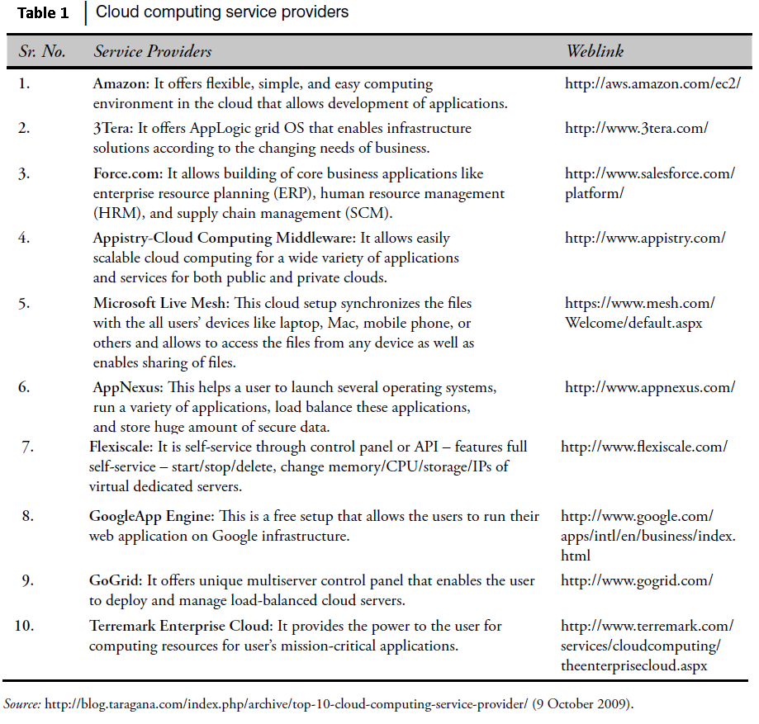

Slide 15
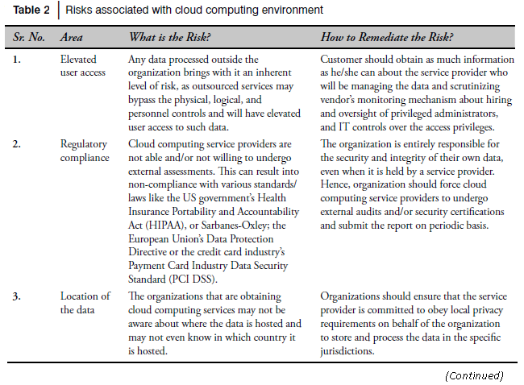
Cybercrime and Cloud Computing
Prime area of the risk in cloud computing is protection of user data.
Table 2 shows the major areas of concerns in cloud computing domain.

Slide 16
